Slide 1




FELIX MUKUNGU
Founder, The Core
Bitcoin Eductor
Graphic Designer
MukunguFelix
Felix Divoar
felixdivoar

Slide 2
CHAPTER 5
UNVEILING THE FUTURE OF MONEY:
AN INTRODUCTION TO BITCOIN

Slide 3
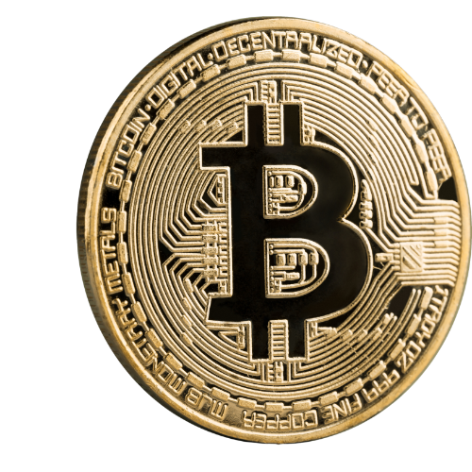
Bitcoin is a revolutionary digital system that allows secure and transparent financial transactions without the need for central authority
Satoshi Nakamoto is the pseudonym used by the unknown person or group of people who created Bitcoin and implemented
The first blockchain database.

Slide 4
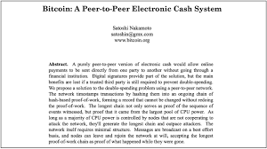
In 2008 Satoshi published a document called “Bitcoin White Paper”, Which explained in details what Bitcoin is, and how it works. He shared it with the entire community of tech enthusiasts
Known a cypherpunks & it quickly gained attention for its innovative approach to digital currency.

Slide 5
Satoshi Nakamoto’s goal for Bitcoin was to create a decentralized digital currency that is accessible to anyone with an internet connection, with transparent & fair transactions that were permanently recorded on a secure, distributed ledger (blockchain)
Satoshi Nakamoto is estimated to have around 1 million bitcoin which would make them one of the richest individuals in the world if their identity were to be relieved
Satoshi Nakamoto’s authored only a few hundreds forum posts and emails in his time but most are still available online to give you a glimpse into the mind and motivations of Satoshi nakamoto

Slide 6
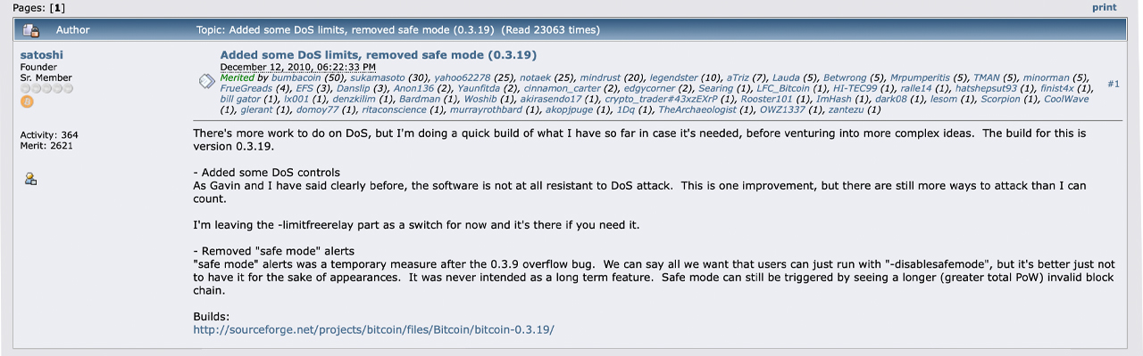
In the early days of Bitcoin, satoshi Nakamoto was quite active in the community answering questions and helping to troubleshoot issues, however, he/she/they abruptly disappeared in 2011 & have not been heard from since

Slide 7

While Satoshi was the primary architecture behind Bitcoin, They
Didn’t work alone, there was undoubtedly influential figure in tech
and cryptography, including Wei Dai & Nick Szabo
Introduction to Bitcoin & bitcoin
OPTIMIST
PESSIMIST
Bitcoiner
The glass
Is half
full
The glass
Is half
empty
The water
Is totally
Centralized

Slide 8
On May 17, 2010 the first known exchange of bitcoin for goods
Took place Lazlo Hanyecz purchased 2 pizzas for 10, 000 BTC
In broad terms, bitcoin is similar to traditional money, but instead of being physical, it exists only on the internet.
What is bitcoin ? What is Bitcoin
Bitcoin (lowercase ‘b’) it is the digital cash that runs on the Bitcoin
network
It is a currency bitcoin ‘bitcoin’ that allows people to send and
Receive payments online, it is called digital because unlike traditional currencies such as the U.S dollar, or the euro, which are physical currencies that can be held in your hand , bitcoin can only be used with the internet .

Slide 9
The Bitcoin Network (Capital ‘B’) it’s everything else; the system, the network, the software, the rules, the community.. Satoshi’s creation.
The Bitcoin network ‘B’ is made of individuals, companies and
Organizations all around the world. They are the ones who keep
The network functional by using and supporting the currency, running the software that powers the network

Slide 10
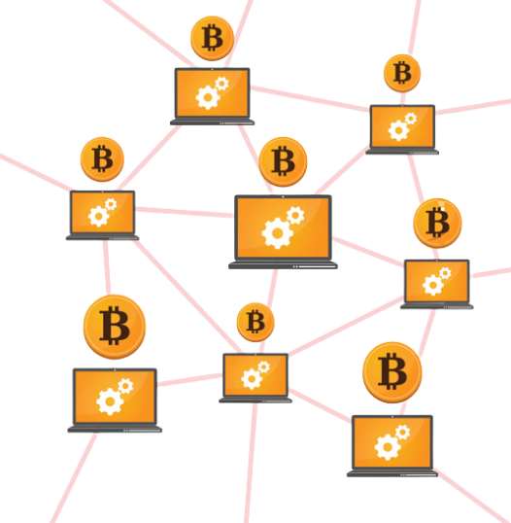
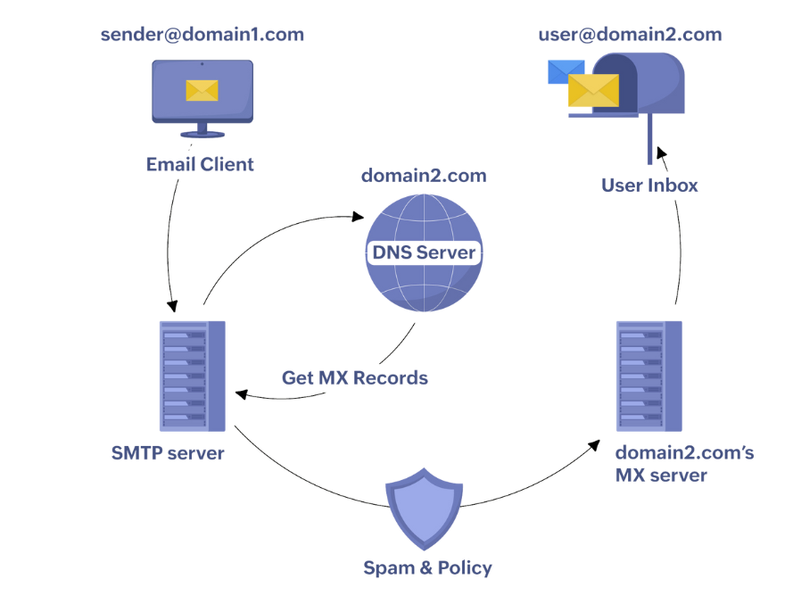
Bitcoin Network provides
Infrastructure for bitcoin to
Be sent and received
Internet provides the infrastructure for emails to be sent and received

Slide 11
Why learn about bitcoin when you can’t afford it
Have you ever thought about using bitcoin but have been put off by the price of a whole bitcoin?
You don’t have to buy a whole bitcoin to start using it.

